Slide 1
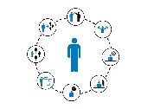
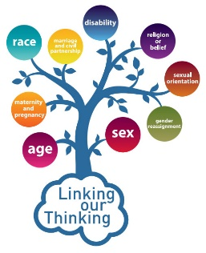
Careers learning Journey
at Compass Learning Centre
Successfully move to training/employment
Successfully move to an apprenticeship
The Law, work, and you
Communication Skills
Resilience and Positive Mindset
Consider signing up for the NCS challenge
Open evenings at post 16 providers
Your personal network
Personal planning
Discrimination in the workplace
Rights and Responsibilities at work
The law and you
Interviews by Local Employers
College interview preparation and interview attendance
Successfully move to college/Sixth Form
Updating or creating CVs
Personal planning
How do I improve my prospects?
Developing financial capability Money and debt
Dream jobs and skills set
Employer Interactions
1:1 Sessions Career interviews
Filling in college and Apprenticeship application forms
Income Tax, Pensions
Employer Interactions
Apprenticeships
Presentation
Employability skills
Planning for the future
Work Experience
Weymouth College
Presentation
Stereotypes
and relationships
Year 11
Employer Interactions
Careers college
Kingston Mauward college
Presentation
Managing change and decision making
How you have changed
1:1 Sessions Career interviews
Equality in the work place
BTEC Personal Growth and Development
Apprenticeships
Setting SMART targets
Discrimination in the workplace
Updating or creating CVs
BTEC Personal Growth and Development
Financial safety and risk
Terms of employment
Stereotypes
and relationships
Work life balance
The power in relationships
Year 10
KS4
My dreams for life
Staying safe at work
Rights and Responsibilities in the workplace
Managing your online presence
Employer Interactions
Understanding difference
The power of planning
What is labour market information? How is it useful to you?
Green Careers Week
Employer Interactions
The power of first impressions
Jobs of the future
Your goals long term
Money and budgeting
Options for GCSE
RAILWEEK
Creating a personal profile
Equality
Resilience
Yr9
Y8 – why is education important?
Yr9
Prejudice and discrimination
How can I make a difference
Inequality
My personal strengths
What influences your job choices?
My Money Week
Managing stress
Digital Footprint
Social Media
Matching skills to jobs
Stereotypes
Change in me and relationships
Developing a “can do” attitude
RAILWEEK
Jobs and careers is an important topic in Life Skills
The power of positive language
Jobs related to subject areas
What are my strengths?
KS3
Careers is taught throughout both KS3 and KS4 at The Compass Learning Centre and aims to widen and raise aspirations
Green Careers week
ALL subjects will have bits of careers education in them as well and you can speak to ANY staff member about careers.
Understanding my support network
Introduction to careers education
Understanding who I am (talents, skills, interests) step towards future career choices.
Stereotypes
celebrating difference
Extensive UK and international research shows that careers in the curriculum can have some positive impacts on outcomes for young people.

